Slide 1
Huron Behavioral Health
FY26 Operating and Capital Budget

Slide 2
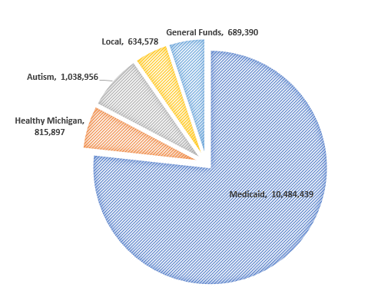
FY26 operating budget - revenue
Total Revenue $13,663,260

Slide 3
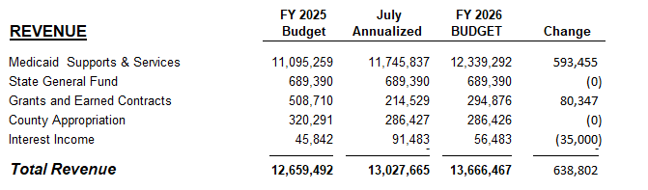
FY26 operating budget

Slide 4
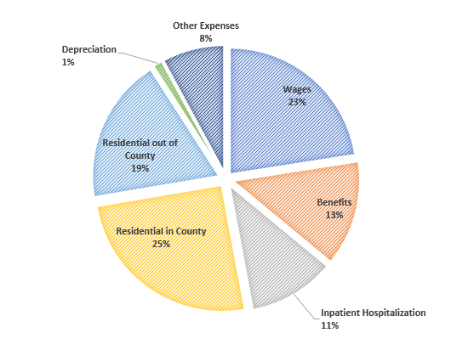
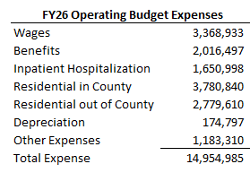
FY26 Operating budget – Expense

Slide 5
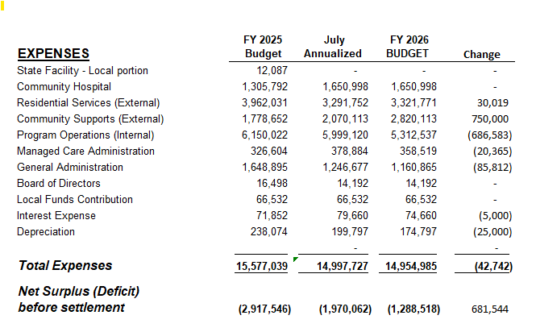
FY26 operating budget

Slide 6
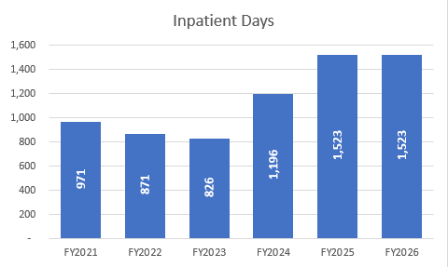
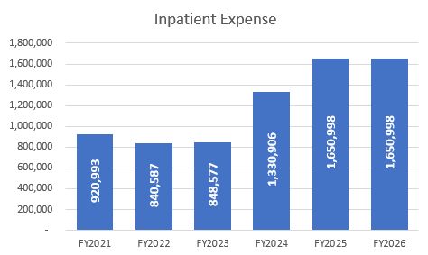
FY26 Operating budget – inpatient hospitalization

Slide 7
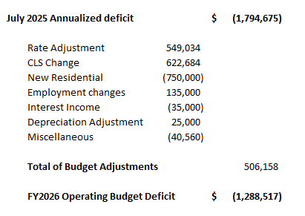
FY26 Operating budget – summary of changes

Slide 8
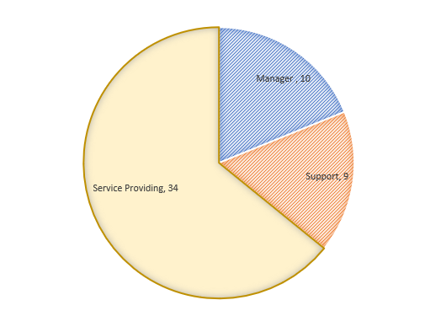
FY26 Operating budget - employees
Total Employees 53

Slide 9
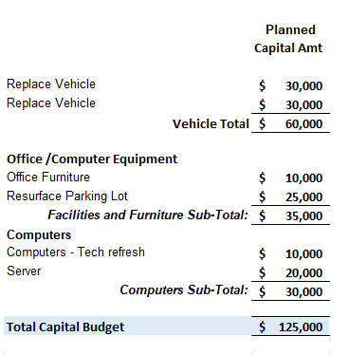
Fy26 capital budget

